Slide 1

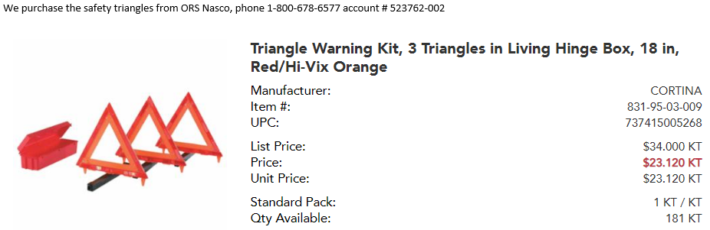
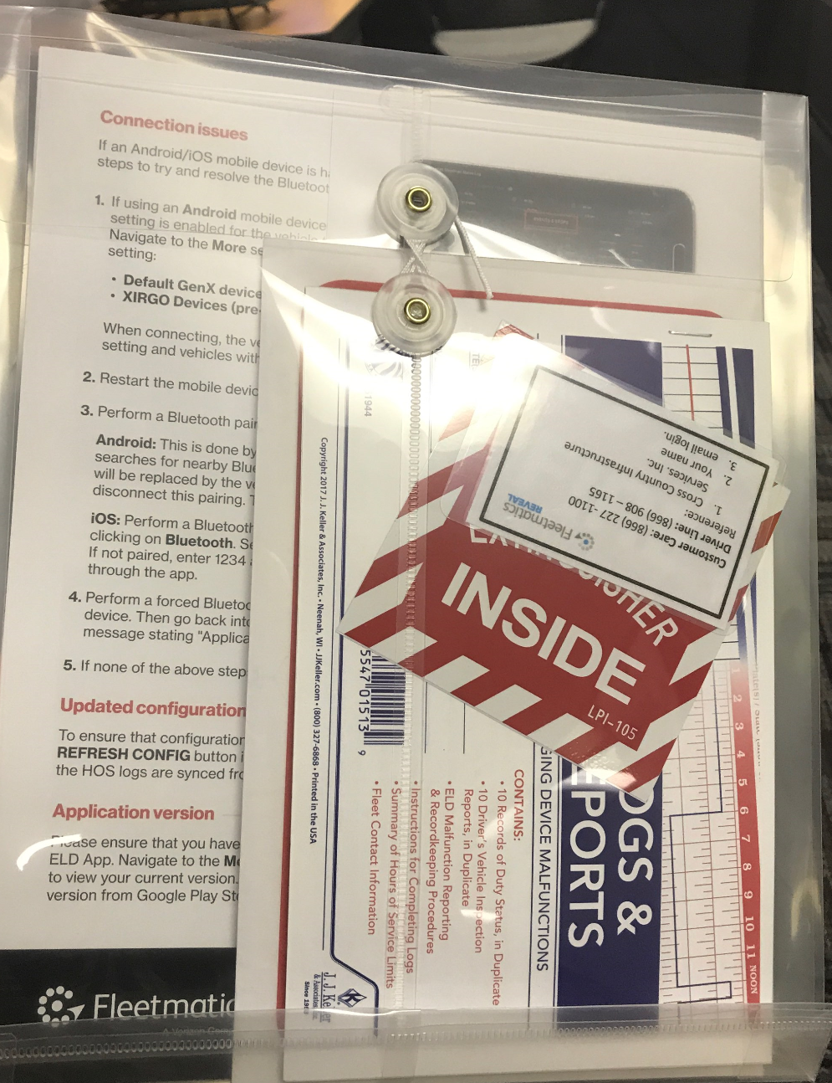
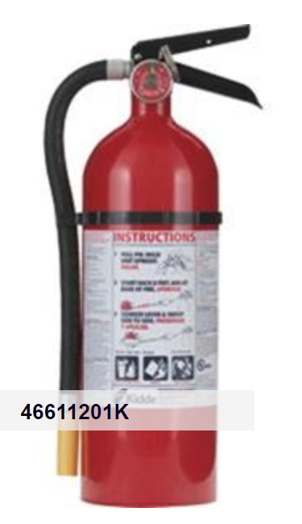
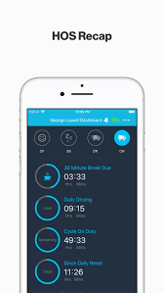
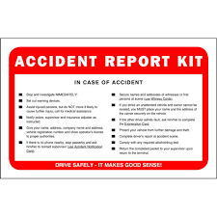

CCIS SAFETY BRIEF
CCIS Vehicle Equipment Requirements
SAFETY TRIANGLES
CCIS VEHICLE INFORMATION PACK
EXTINGUISHERS
DRIVER VEHICLE INSPECTION REPORT
(DVIR) & MAINTENANCE
5 lb ABC Extinguisher with Vehicle Bracket
ALL DEFFECTIVE ITEMS LISTED ON THE DVIR MUST BE REPAIRED ASAP.
CCIS LOGOS AND DOT MARKINGS
Vehicle Accident Report (VAR) Kit
USDOT 573610 CO
CONTACT SAFETY@CROSSCOUNTRYIS.COM IF YOU NEED ANY OF THESE

Slide 2
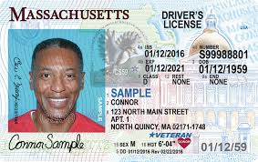
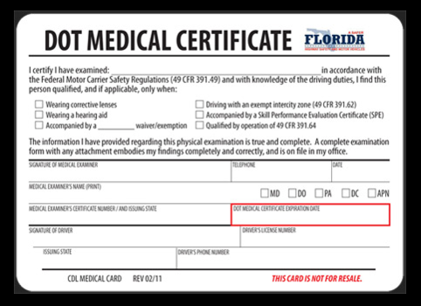
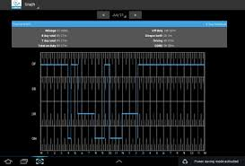
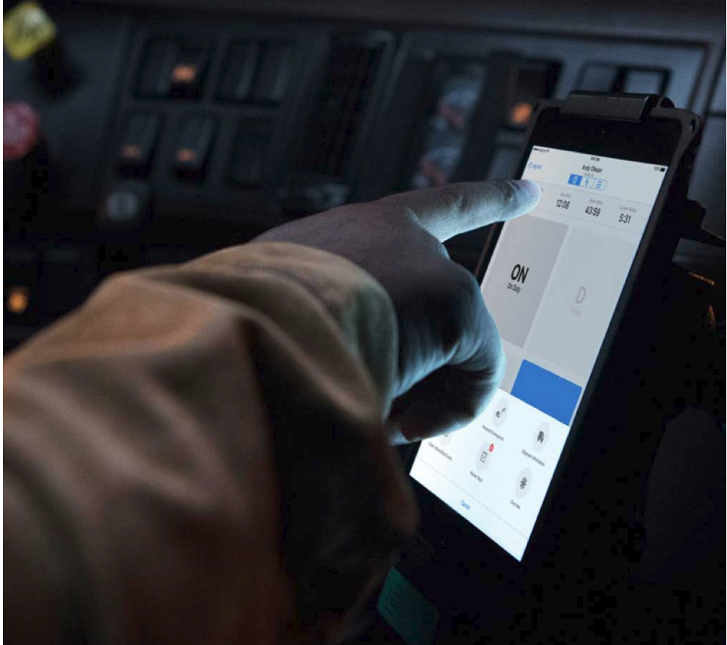
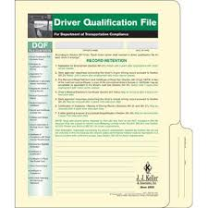
CCIS SAFETY BRIEF
CCIS Regulated Driver Requirements
VALID DRIVER OR COMMERCIAL LICENSE
CURRENT ANNUAL PHYSIAL CARD
ELD LOGBOOK MUST MATCH TIMECARD
DRIVER ELD
DRIVER QUALLIFICATIONS (DQ) FORMS COMPLEATED
DRIVER MUST HAVE SEATLBELT ON WHEN THE VEHICLE IS NOT IN PARK.

