Slide 1



Triage

Slide 2



Our Triage Experience
Patient Focused Care. Superior Service.
Positive employee experience following an injury
Follow up care text instructions for every injured worker
Documentation of
the appropriate details following the injury
Identifies appropriate level of care for the injured employee
24/7 hotline for medical advice
and care instructions

Slide 3
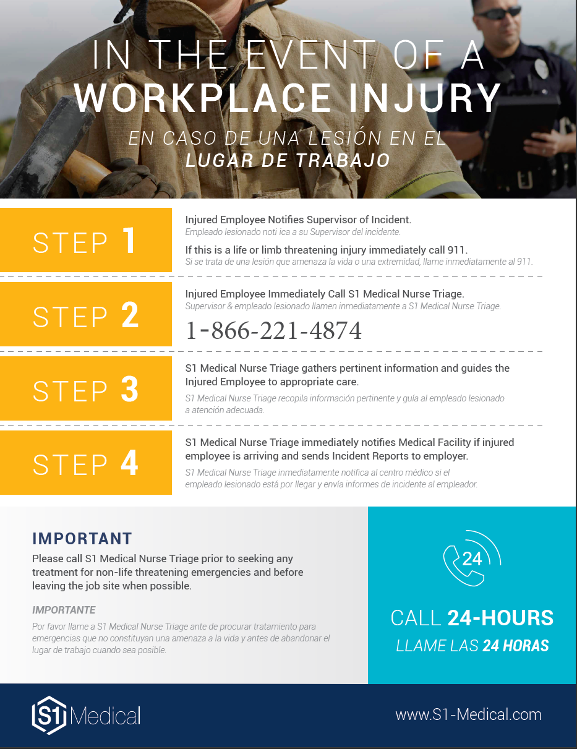
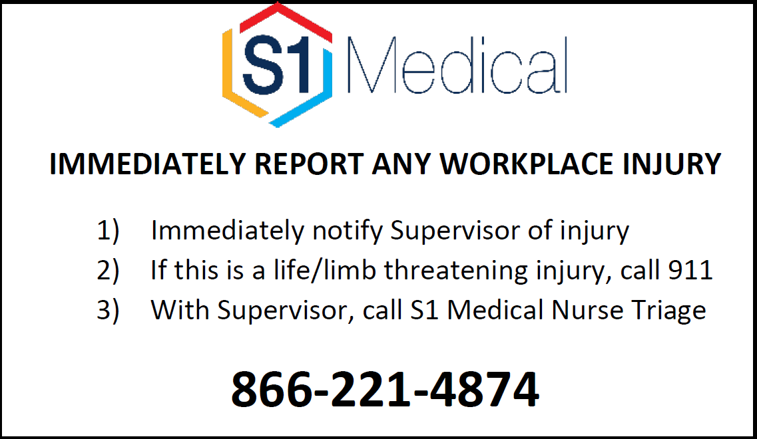
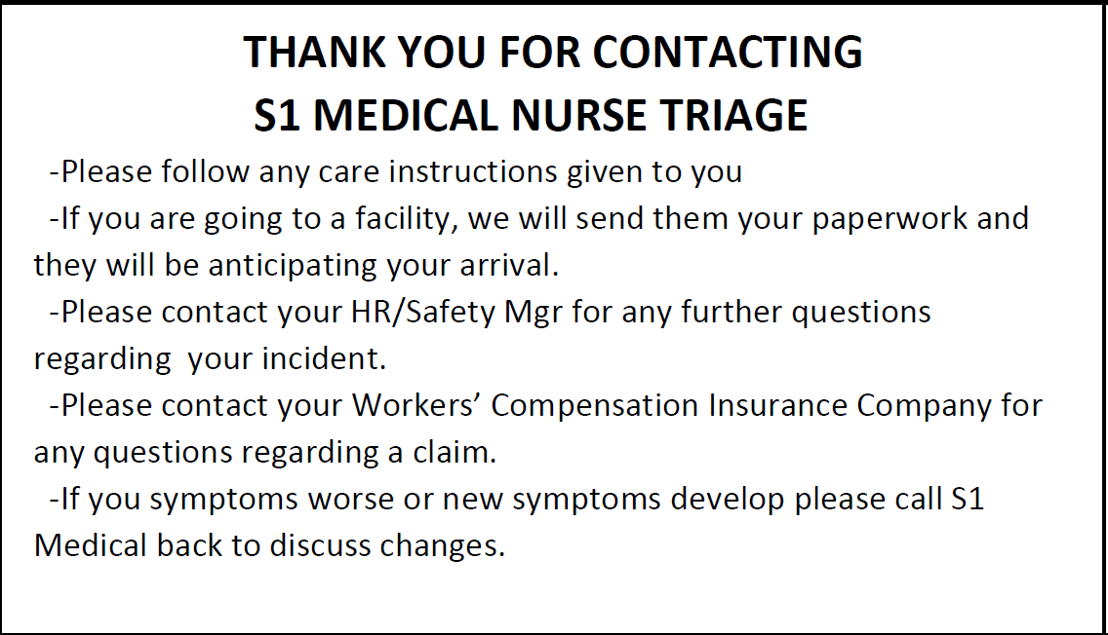
EDUCATION – SPREADING THE WORD
An employee perspective
Custom Phone Number
866-221-4874
(FRONT)
Poster
Place in a prominent place in each work location
Wallet Cards
Give to employees and/or supervisors
(BACK)

Slide 4
INITIATING TRIAGE – WHEN TO CALL
An employee perspective
ALL WORK-RELATED INJURIES
CALL BEFORE YOU SEEK TREATMENT
Employees/Supervisors should call S1 Medical for all work-related injuries for appropriate care and reporting purposes.
Employees/Supervisors should call S1 Medical BEFORE the employee seeks treatment to receive the appropriate level of care
CALL EVEN IF YOU FEEL IT IS NOT IMPORTANT
CALL EVEN IF YOU THINK TREATMENT IS NOT NEEDED
Details such as medications or medical history may factor into treatment advice.
Many times, homecare remedies will alleviate pain and avoid worsening symptoms.
EMERGENCY
If the injury is life threatening, the employee is unconscious or bleeding profusely, etc. call 911 and call Triage when the employee is stable.

Slide 5



The Service Profile
How do we define triage?
Who
When
TIME OF INJURY
Designed to be a service for the time of incident,
Available 24/7.
REGISTERED NURSES
Registered Nurses, triage trained, handling all calls.
What
Why
FROI MEDICAL CALL CENTER
Assess, document and provide care advice
APPROPRIATE CARE RESOURCE
Facilitating the right level of care from the first day.
Triage
Demographic Info
Incident Info
Care Advice
E-Mail Notification
- Incident Details
- First Report
- Provider Notification
- OSHA 300
- Other Forms
Incident
Call
Injury Info
Care Advice
Text Message

